Slide 2
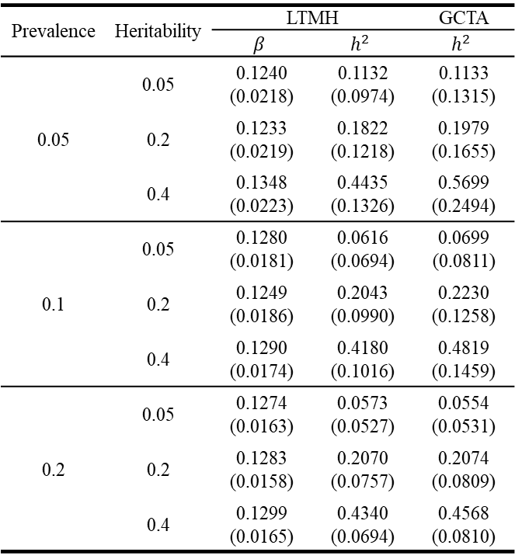
table 1
Prevalence | Heritability | LTMH |  | GCTA
 |  | $$β$$ | $$h^{2}$$ | $$h^{2}$$
0.05 | 0.05 | 0.1240 (0.0218) | 0.1132 (0.0974) | 0.1133 (0.1315)
 | 0.2 | 0.1233 (0.0219) | 0.1822 (0.1218) | 0.1979 (0.1655)
 | 0.4 | 0.1348 (0.0223) | 0.4435 (0.1326) | 0.5699 (0.2494)
0.1 | 0.05 | 0.1280 (0.0181) | 0.0616 (0.0694) | 0.0699 (0.0811)
 | 0.2 | 0.1249 (0.0186) | 0.2043 (0.0990) | 0.2230 (0.1258)
 | 0.4 | 0.1290 (0.0174) | 0.4180 (0.1016) | 0.4819 (0.1459)
0.2 | 0.05 | 0.1274 (0.0163) | 0.0573 (0.0527) | 0.0554 (0.0531)
 | 0.2 | 0.1283 (0.0158) | 0.2070 (0.0757) | 0.2074 (0.0809)
 | 0.4 | 0.1299 (0.0165) | 0.4340 (0.0694) | 0.4568 (0.0810)

Slide 3
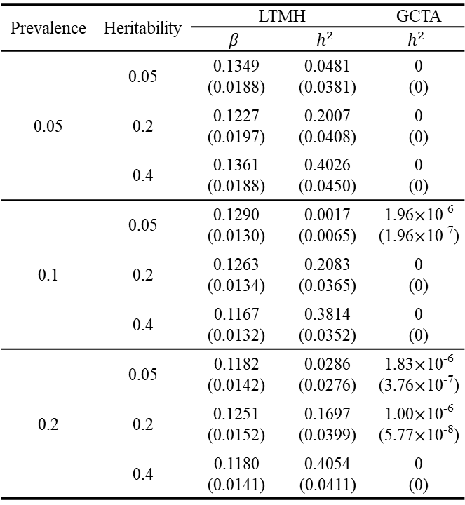
table 2
Prevalence | Heritability | LTMH |  | GCTA
 |  | $$β$$ | $$h^{2}$$ | $$h^{2}$$
0.05 | 0.05 | 0.1349 (0.0188) | 0.0481 (0.0381) | 0 (0)
 | 0.2 | 0.1227 (0.0197) | 0.2007 (0.0408) | 0 (0)
 | 0.4 | 0.1361 (0.0188) | 0.4026 (0.0450) | 0 (0)
0.1 | 0.05 | 0.1290 (0.0130) | 0.0017 (0.0065) | 1.96$×$10⁻⁶ (1.96$×$10⁻⁷)
 | 0.2 | 0.1263 (0.0134) | 0.2083 (0.0365) | 0 (0)
 | 0.4 | 0.1167 (0.0132) | 0.3814 (0.0352) | 0 (0)
0.2 | 0.05 | 0.1182 (0.0142) | 0.0286 (0.0276) | 1.83$×$10⁻⁶ (3.76$×$10⁻⁷)
 | 0.2 | 0.1251 (0.0152) | 0.1697 (0.0399) | 1.00$×$10⁻⁶ (5.77$×$10⁻⁸)
 | 0.4 | 0.1180 (0.0141) | 0.4054 (0.0411) | 0 (0)

